Slide 1





SVBTCC VISION
SRI VENKATESHWARA BALAJI TEMPLE & CULTURAL CENTRE (SVBTCC)
LONDON
SVBT TEAM
contact@svbtcc.org
07813 191 623
January’2019
http://www.svbtcc.org

Slide 2

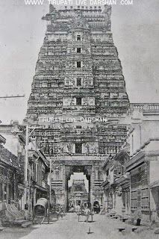

As per Sanatana Vaidika Dharma…. God is everywhere.
He is Omnipresent, thus when GOD is everywhere !
Why we need a Temple ?
As Lord Krishna says in the Gita –
aśhraddhayā hutaṁ dattaṁ tapas taptaṁ kṛitaṁ cha yat
asad ity uchyate pārtha na cha tat pretya no iha॥
Whatever you do without faith – be it homa, tapas, charity, or anything else – that will not bear fruit for you. Then, just because we did not get the fruits of our actions because of our lack of faith, criticising the Shastras is not in the least bit right. Hence faith & belief is very necessary for us.
We should perform that Karma(task) with this belief. Further, if one asks why we build a temple , why we consecrate (an idol of) God/Power inside…it is for common man (Mandaadhikaari), who does not have the spiritual maturity to see God everywhere.
In our lives, sorrow and happiness are come one after the other. During happiness, we do not even know the days are passing, But when difficulties arise, we will be suffering not knowing what to do. At that time, to whom can we go? Whom shall we tell our sufferings to? Who will dispel our sufferings?
Temple reflects a synthesis of Spirituality, Education, Wellbeing, Arts, Social Values, the ideals of dharma, beliefs, values, and the way of life cherished under
Hindu Dharma
http://www.svbtcc.org
contact@svbtcc.org
svbtcc@gmail.com
07813 191 623

Slide 3
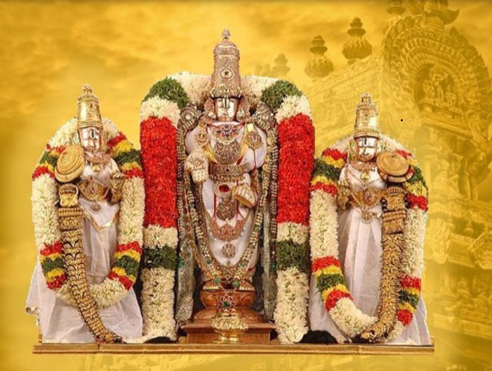

Why : Sri Venkateshwara Temple in London?
Sloka: ”vEnkatAdri samam sthAnam brahmAndE nAsti kinchana, vEnkatEsa samO dEvO na bhUtO na bhavishyati"
Aditya purAnam and varAha purAnam.. Which means
"In this Universe there is no sacred place equivalent to Venkatadri(i.e.,There is no place in the whole Universe which is more auspicious than the hill Venkatachala). There is no God equivalent to Lord Venkateswara in all the three times (present, past and future) in Kaliyuga whose glories are comparable to the Lord of Venkatachalapathi’’
The Hindu community(c. 800k & 7% of London population) ) in a global city like ‘London’ deserves an opportunity to build and maintain a temple for Sri Venkateswara (Balaji) to full fill their spiritual needs by attaining divine blessings from ‘KALIYUGA DAIVAM’
Approximately 600 k visitors (per year) from India to UK, number is growing at c 30% every year.
London is a major educational, international business and health care destination for Indians.
http://www.svbtcc.org
contact@svbtcc.org
svbtcc@gmail.com
07813 191 623

Slide 4

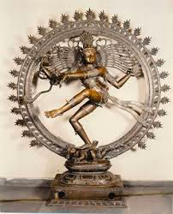




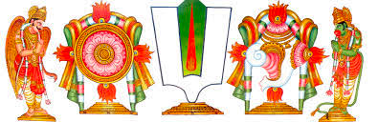
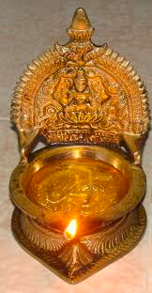
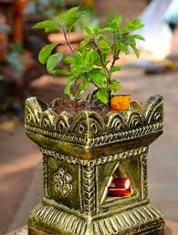
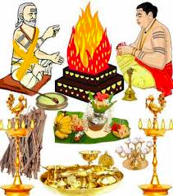
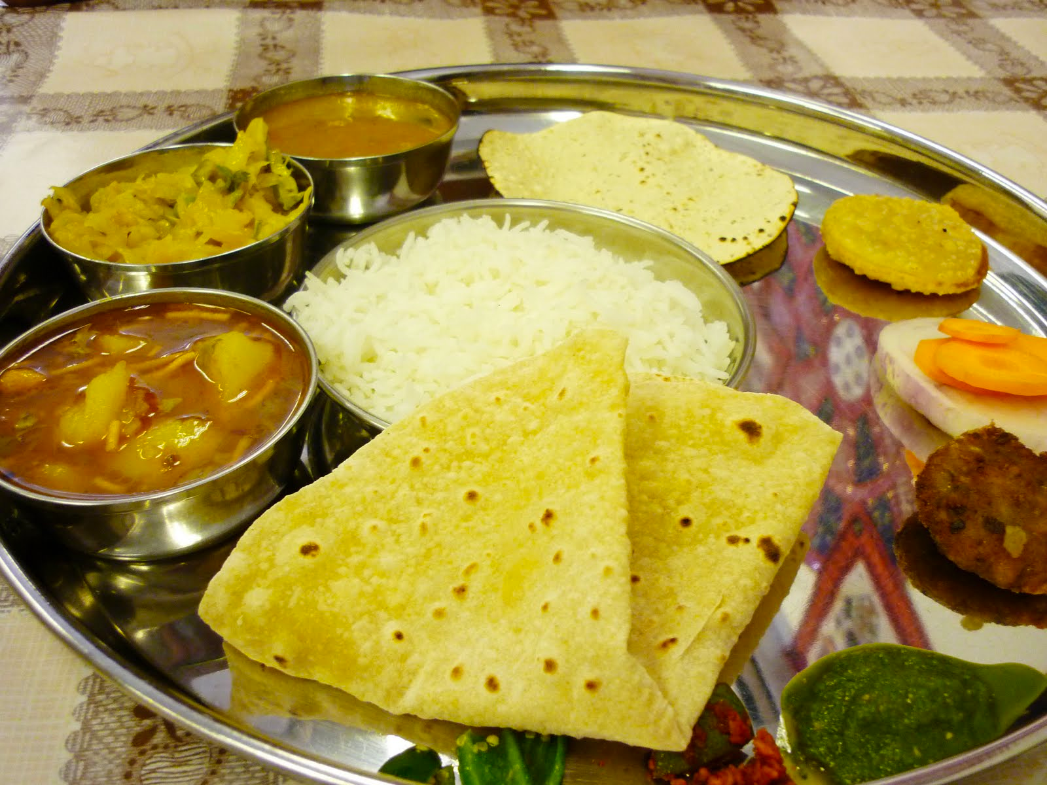
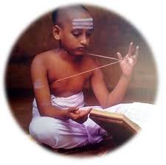
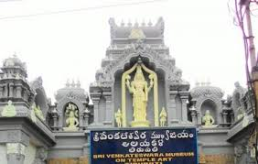
SVBTCC Vision - Balaji’s Village @ London
Sri Thyagaraja’s
Cultural Centre
Garuda’s
Bharat Darshan
(Museum)
Srivari Vaikuntam
(Temple)
-Dharmic, Spiritual & Religious
Hanuman’s
Well-being
Centre
Annapoorna’s
Food Court
http://www.svbtcc.org
contact@svbtcc.org
svbtcc@gmail.com
07813 191 623

Slide 5
SVBTCC : Balaji’s Village
@ London – a Detailed Note
Sri Venkateshwara Temple :
A unique, well maintained providing highest quality services (Worships, Dharmic, Spiritual & Religious activities) to it's devotees, attracting them from all over the country and Europe.
An iconic place that will be constructed and develop the village with the support of Tirumala Tirupathi Devastanams(TTD, India) , built with 100% Vasthu and Vaikhanasa Agama Shasthram.
Temples for Sri Ganapathi, Sri Venkateshwara Swamy, Siva & Parvathi and Nava Grahams. Guru Stanam- Sri Dattatreya and Adi Sankara. Yagasala/Govu Samrakshana kendram.
Administrative block for Temple Management. Accommodation for Priests. Temple kitchen & dining hall for Annaprasadam distribution.
Pushkarini (Temple tank) along with Talaneelalu Katta /Hall for Kesakhandana.
To be built to represent Indian Temple Architecture integrated with local conditions, added with green-landscape through out the premises.
        Note: Other Deities within the premises (Kumara Swamy, Shirdi Sai Baba, Sri Vasavi Kanyaka Parameshwari, Seetha Rama and Radha Krishna; Satyanarayana Swamy) may be instilled as we make progress with the temple project.
Sri Thyagaraja’s Cultural Centre:
To Promote Bharath’s (Indian) Dance, Music, Values, Traditions, with seating capacity of c 2.5 k
To run a music and dance schools to promote local talent.
Language classes, resource centre (book stalls, store for pooja materials, Helpdesk)
Available for Weddings, Birthday parties, Shastipoorthi..etc .
Special cultural /motivational programs for Children & Youngsters (5-25 yrs)
http://www.svbtcc.org
contact@svbtcc.org
svbtcc@gmail.com
07813 191 623

Slide 6
SVBTCC : Balaji’s Village
@ London – a Detailed Note
Hanuman’s Well-being Centre:
Yoga and recreation Centre. Place of promoting peace in the name of Gandhi.
Annamayya complex: Accommodation for visitors/ pilgrims, retirement homes for who would like to spend life in spirituality.
Indian medicine - Ayurveda medical stores. First aid centre.
Annapoorna’s Food Court:
Indian food stalls( North & South) attached to Cultural Centre & Well-being Centre.
Training on cooking-Indian food.
Garuda’s Bharath Darshan (Museum)
Sri Venkateshwara Swamy Mahatyam & Story; Tirumala - Pictorial & Audio/Video displays.
Museum depicting Sanatana Dharma - Dharmic Centre (like Sankaracharya’s peetams)
Exhibiting arts, dance, music, heritage, culture of various parts of India.
Others:
Thulasi Vanam-Brindavanam( Green house) ; Children play-area & Nursery.
Green landscape with Swamy’s Namalu, Shankam and Chakram which makes the premises to feel the devotees are in SRI VARI VAIKUNTAM.
Large Car parking.
http://www.svbtcc.org
contact@svbtcc.org
svbtcc@gmail.com
07813 191 623

Slide 7
SVBTCC Team,
Objectives & Mission
SVBT & CC will function as a ‘non profit’ organisation/Charity Institution with a central purpose of serving the devotees in the UK & Europe, to promote Hindu Sanatana Dharma and Hindu Culture, Values & Traditions.
The Core Members Team:
The team consists of well-regarded professionals like Doctors, Lawyers, Technocrats, Bankers, Philanthropists, Home-makers and all walks of life people with only one common connection of ‘Devotion & Service to Sri Venkateshwara Swamy’. The team also consists of Devotees who worked for Sri Venkateshwara (Balaji ) temple, Birmingham from the beginning, to share their expertise and guide the team through the process.
Objectives :
The advancement of the Hindu Sanatana Dharma(Hindu religion) among communities by:
The provision of safe and easy access for regular worship and fellowship.
Raising awareness about ‘Hindu Sanatana Dharma’ (Hinduism) and inculcating Hindu values and culture in our family life and to foster pride in our heritage among the younger generation.
Raising awareness of yoga, meditation, the arts, spiritual and inter-religious education to promote religious and social tolerance.
Working with other interfaith groups to promote harmony, integration and peace
Establishing a Cultural Centre and a Temple for worship in order to achieve the objective
Mission :
Service To Communities through devotion and dedication
http://www.svbtcc.org
contact@svbtcc.org
svbtcc@gmail.com
07813 191 623

Slide 8
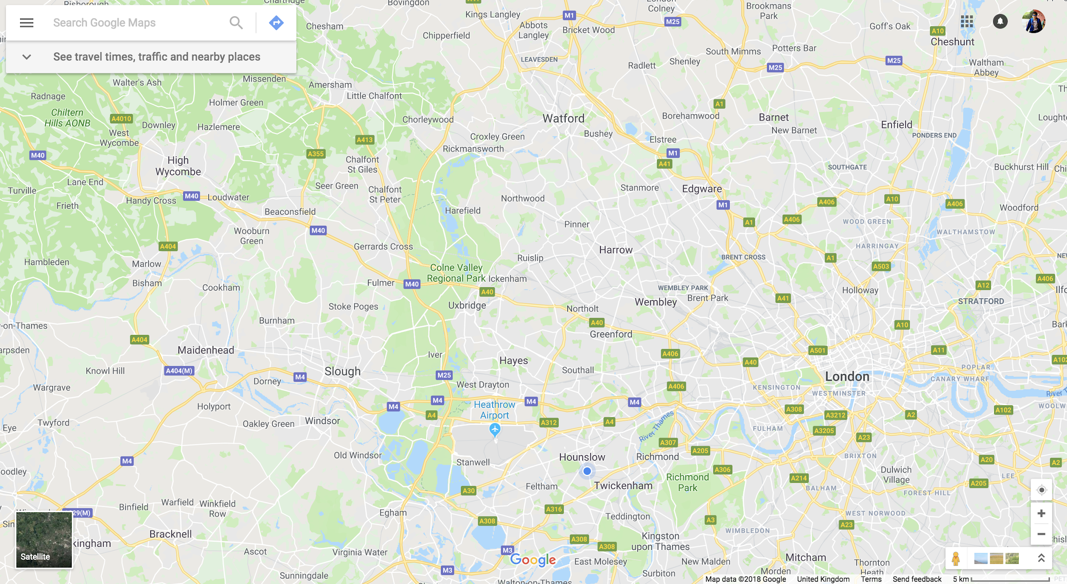
SVBTCC - Land Searching Limits(indicative only)
c25 acres; around M25 between M3(+5 mils) to M.
Looking for D1-Hall/Place of Worship (in Hounslow, Feltham, Hayes, Staines..etc) for 3-5 years long lease.
http://www.svbtcc.org
contact@svbtcc.org
svbtcc@gmail.com
07813 191 623

Slide 9
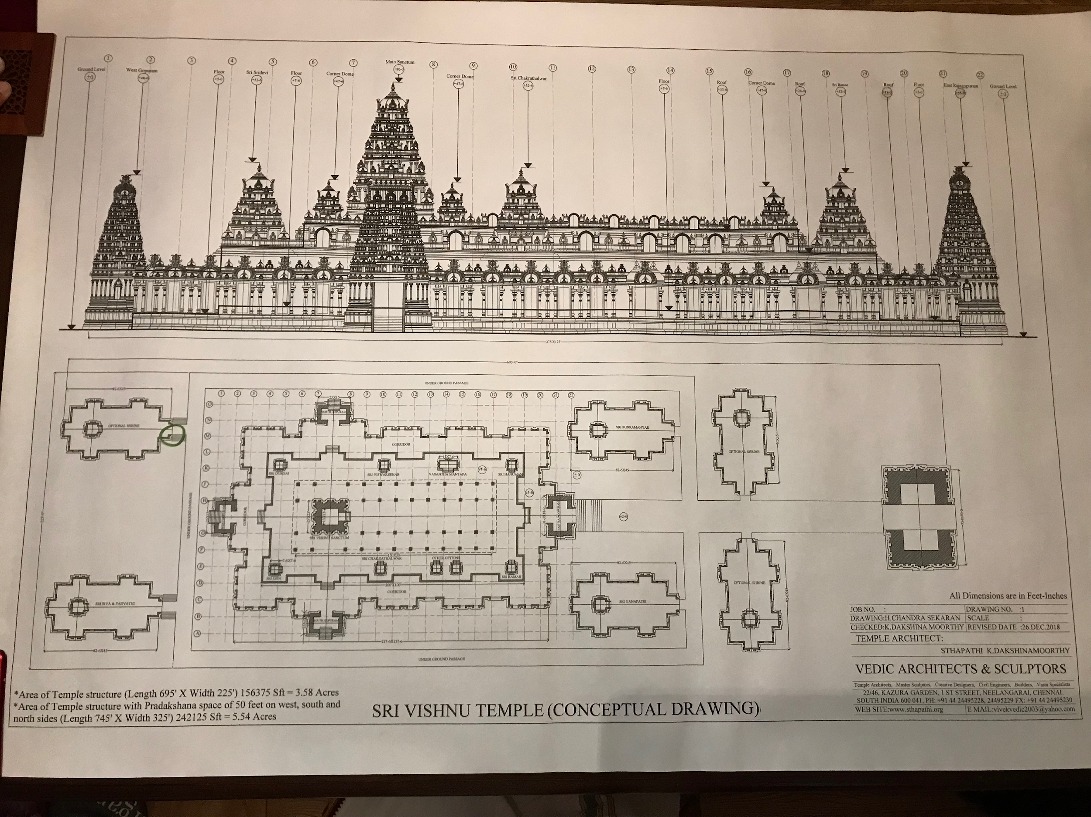

Slide 10
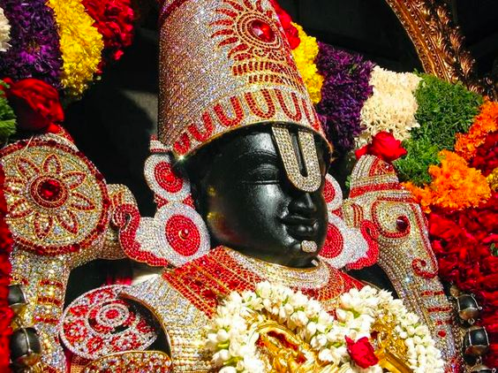
Everyone is part of the Service to Sri Venkateshwara.
Every penny is accounted, transparent and efficient administration of funds & organisation.
Everyone’s contribution will be recognised by SVBT and rewarded by Sri Venkateshwara Swamy.
Please come and join us in this Divine journey.
Om Namo Narayanaya - Om Namo Venkateshaya
Thanks !
http://www.svbtcc.org
contact@svbtcc.org
svbtcc@gmail.com
07813 191 623

